Slide 1

Basketball
Is there optimal weight for a player?
Itai Markovetzky
Shaked Yehiel

Slide 2
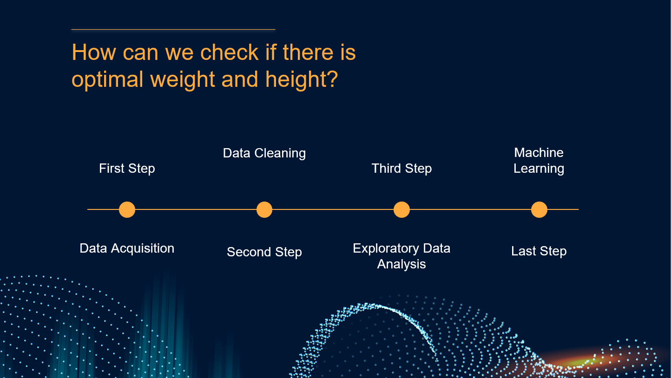
How can we check if there is optimal weight and height?
First Step
Third Step
Second Step
Last Step
Data Cleaning
Machine Learning
Data Acquisition
Exploratory Data Analysis

Slide 3
Data Acquisition

Slide 4

Data Acquistion Process
RealGM
Kaggle
most the details about the players of the NBA since 1996.
We used a crawler for that!
We took and apply some of the data in that pre-made database about our players to add more features to each player including weight and height

Slide 5
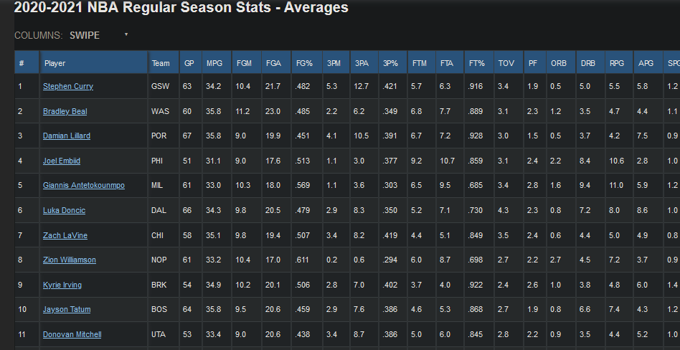
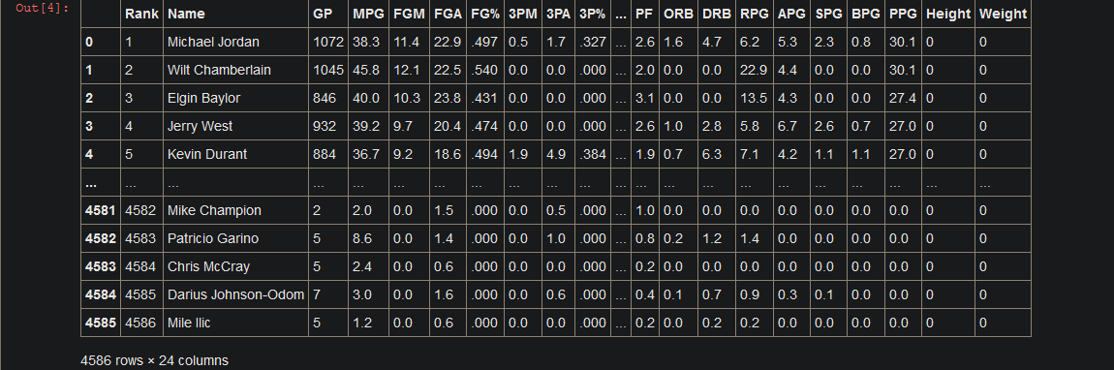
We used “BeautifulSoup” to crawl the tables of the NBA Players from RealGM and saved them into a dataframe.

Slide 6
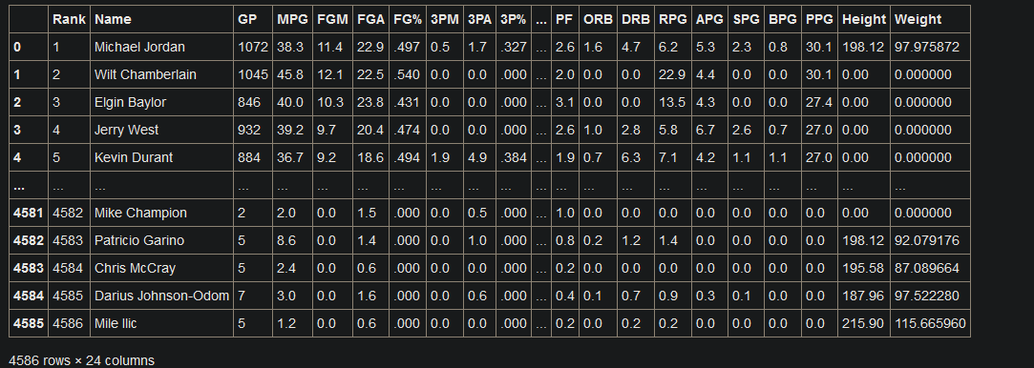
To update the “Height” and “Weight” columns we combined the dataframe we achieved with the premade dataframe from Kaggle
And as a result we achieved our first dataframe to work with!

Slide 7
Data Cleaning

Slide 8

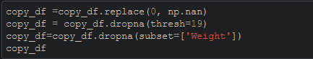
The cleaning process
Removed duplicates
Removed empty columns using thresh of 19
Removed players without weight

Slide 9
114650
74760
39408
Amount of Data before the cleaning
Amount of Data after the first cleaning
Amount of Data on the final dataframe

Slide 10
EDA - Visualization

Slide 11
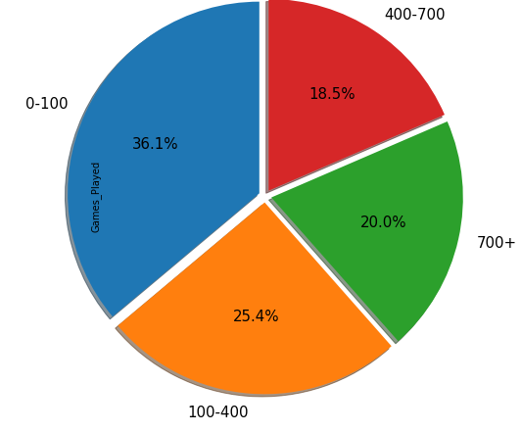
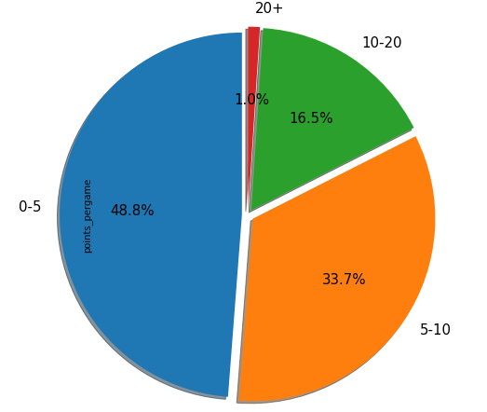
EDA – Pie Charts
Games played:
Points per game:

Slide 12
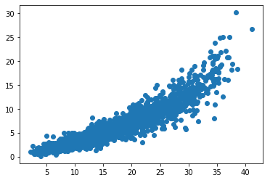
EDA – Scatter
X stands for MPG (Minutes Per Game)
Y stands for PPG (Points Per Game)
The conclusion about this scatter graph is that the more minutes you play the more points you make per game.

Slide 13
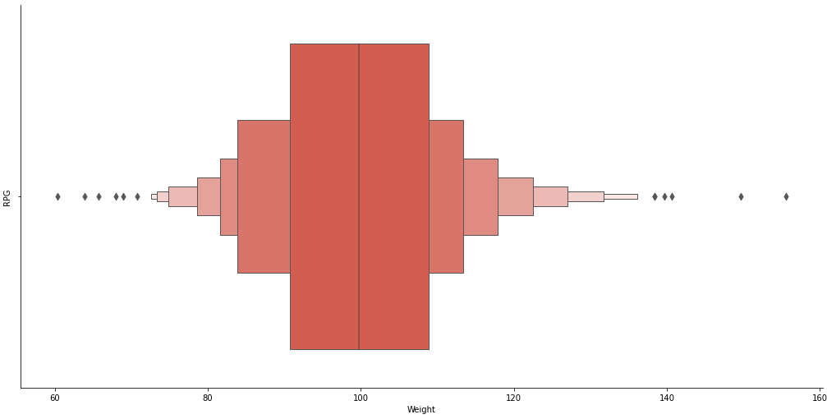
EDA – Catplot
The conclusion about this catplot graph the most optimal weight is between 90 to 110
X stands for Weight
Y stands for RPG (Rebounds per game)

Slide 14
Machine Learning

Slide 15
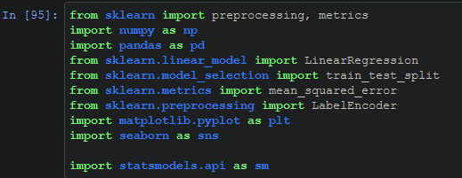
The Machine Learning Process
With the use of “Sklearn” library and Linear Regression we we’re able to find and tweak a model that predicts the optimal weight for each NBA player in our dataframe!

Slide 16
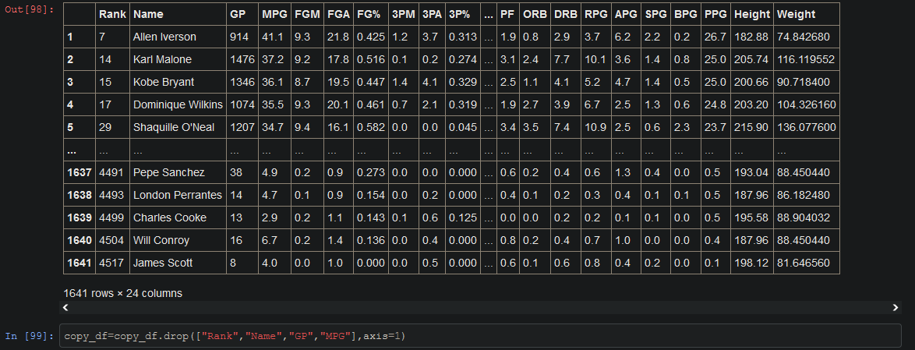
We used the following columns for the study
FGM (Field Goals Made)
FGA (Field Goals Attempted)
FG% (Field Goal Percent)
3PM (3 Points Made)
3PA (3 Points Attempted)
3P% (3 Points Percent)
FTM (Free Throws Made)
FTA (Free Throws Attempted)
FT% (Free Throws Percent)
TOV (Turnovers)
PF (Personal Foul)
ORB (Offensive Rebounds)
DRB (Defensive Rebounds)
RPG (Rebounds per game)
APG (Assists per game)
SPG (Steals per game)
BPG (Blocks per game)
PPG (Points per game)
Height

Slide 17
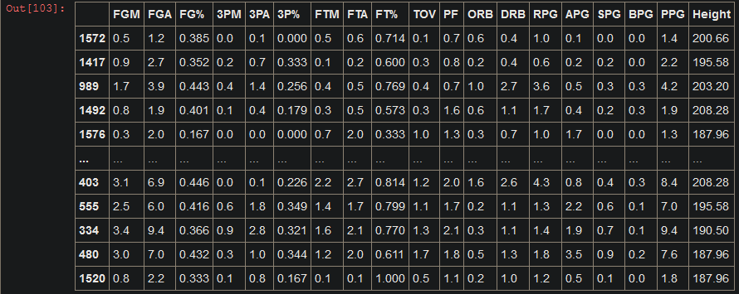
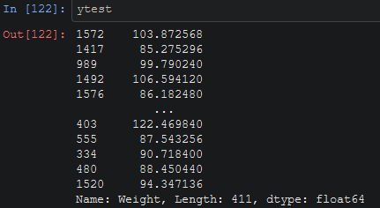
Xtest
Ytest

Slide 18
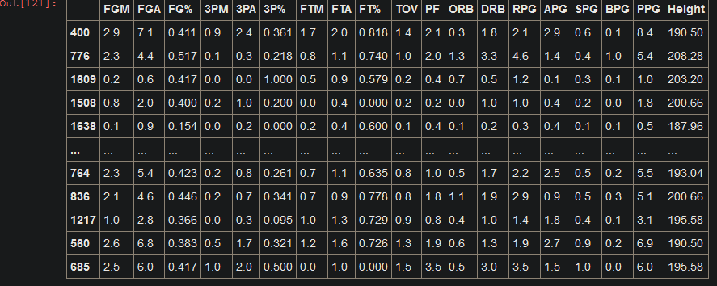
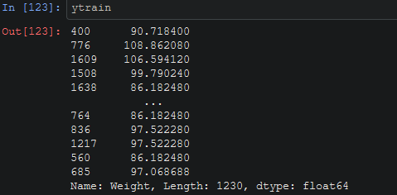
Xtrain
Ytrain

Slide 19
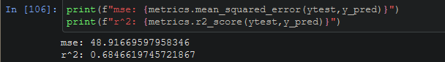
68.466%
That’s our first result!

Slide 20
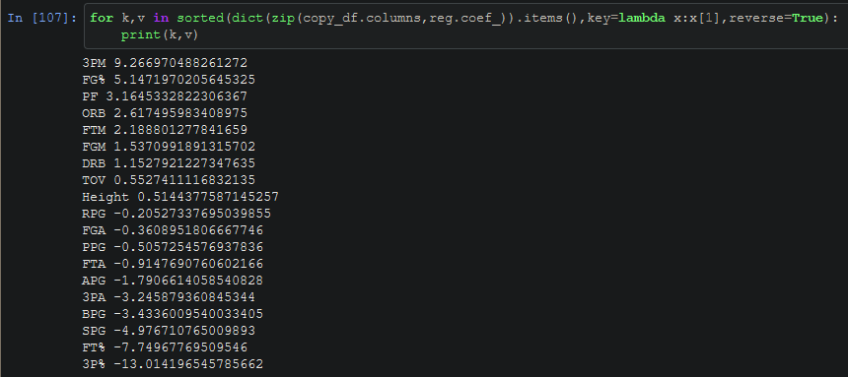
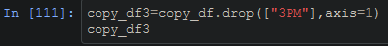
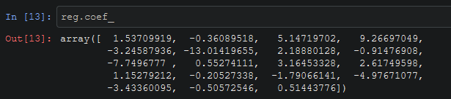
After the result we tried to tweak our model:

Slide 21
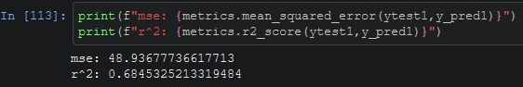
68.453%
That’s our second result!

Slide 22
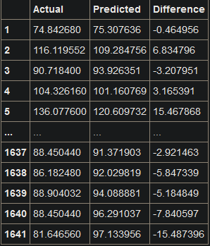
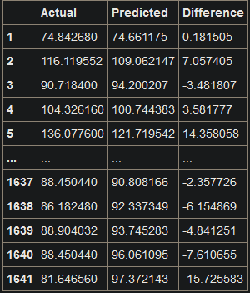
Conclusions and results!
First Result
Second Result

Slide 23
Thank you

